Slide 1

Network+ Guide to Networks 6th Edition
Chapter 5
Topologies and Ethernet Standards

Slide 2
Objectives
Describe the basic and hybrid LAN topologies, and their uses, advantages, and disadvantages
Describe the backbone structures that form the foundation for most networks
Compare the different types of switching used in data transmission
Explain how nodes on Ethernet networks share a communications channel
Identify the characteristics of several Ethernet standards

Slide 3
Simple Physical Topologies
Physical topology
Physical network nodes layout
Depicts broad scope
Does not specify:
Device types
Connectivity methods
Addressing schemes
Fundamental shapes
Bus, ring, star
Hybrid

Slide 4
Bus
Bus topology
Single cable connects all network nodes
No intervening connectivity devices
One shared communication channel
Physical medium
Coaxial cable
Passive topology
Node listens for, accepts data
Uses broadcast to send

Slide 5
Bus (cont’d.)
Terminators
50-ohm resistors
Stop signal at end of wire
Signal bounce
Signal travels endlessly between two network ends
One end grounded
Removes static electricity

Slide 6
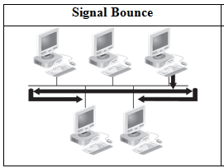
A non terminated bus topology network
Courtesy Course Technology/Cengage Learning

Slide 7
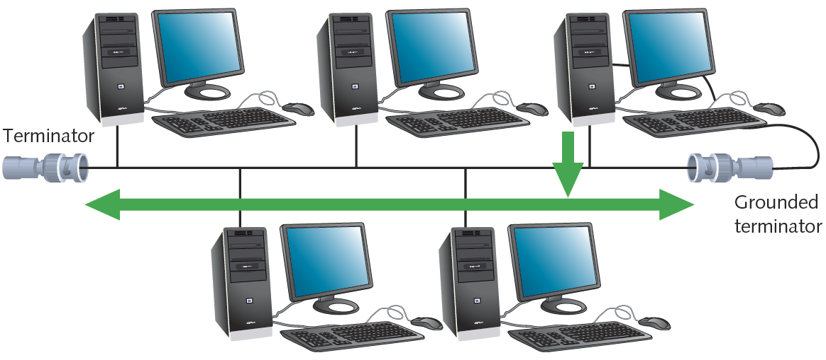
A terminated bus topology network
Courtesy Course Technology/Cengage Learning

Slide 8
Bus (cont’d.)
Bus topology advantage
Relatively inexpensive
Disadvantages
Does not scale well
Difficult to troubleshoot
Not very fault tolerant

Slide 9
Ring
Ring topology
Node connects to nearest two nodes
Circular network
Clockwise data transmission
One direction (unidirectional) around ring
Active topology
Workstation participates in data delivery
Data stops at destination
Physical medium
Twisted pair or fiber-optic cabling

Slide 10
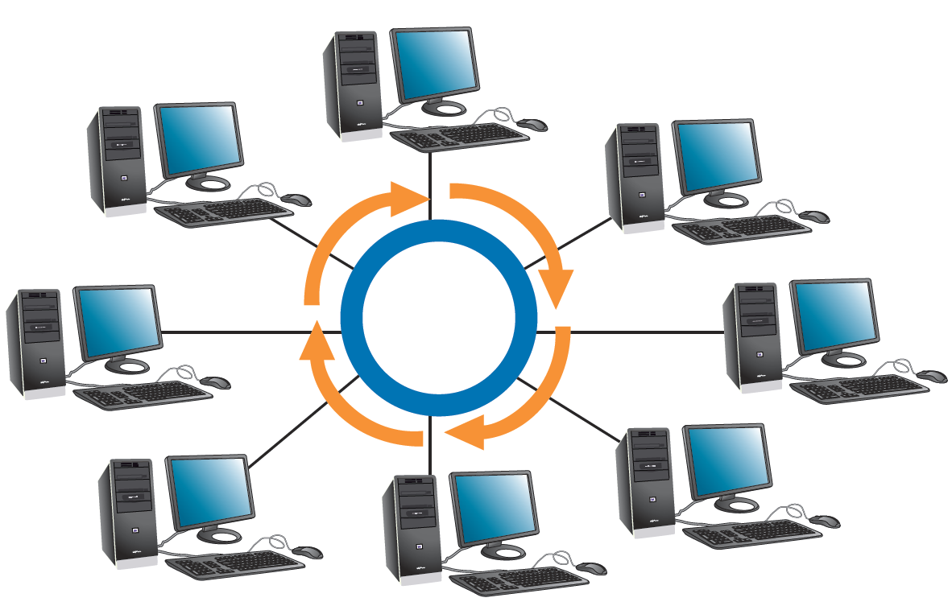
Ring (cont’d.)
Drawbacks
Malfunctioning workstation can disable network
Not very flexible or scalable
Figure 5-2 A ring topology network
Courtesy Course Technology/Cengage Learning

Slide 11
Star Topology
Node connects through central device
Router or switch
Physical medium
Twisted pair or fiber-optic cabling
Single cable connects only two devices
Advantage
Fault tolerant
Flexible

Slide 12
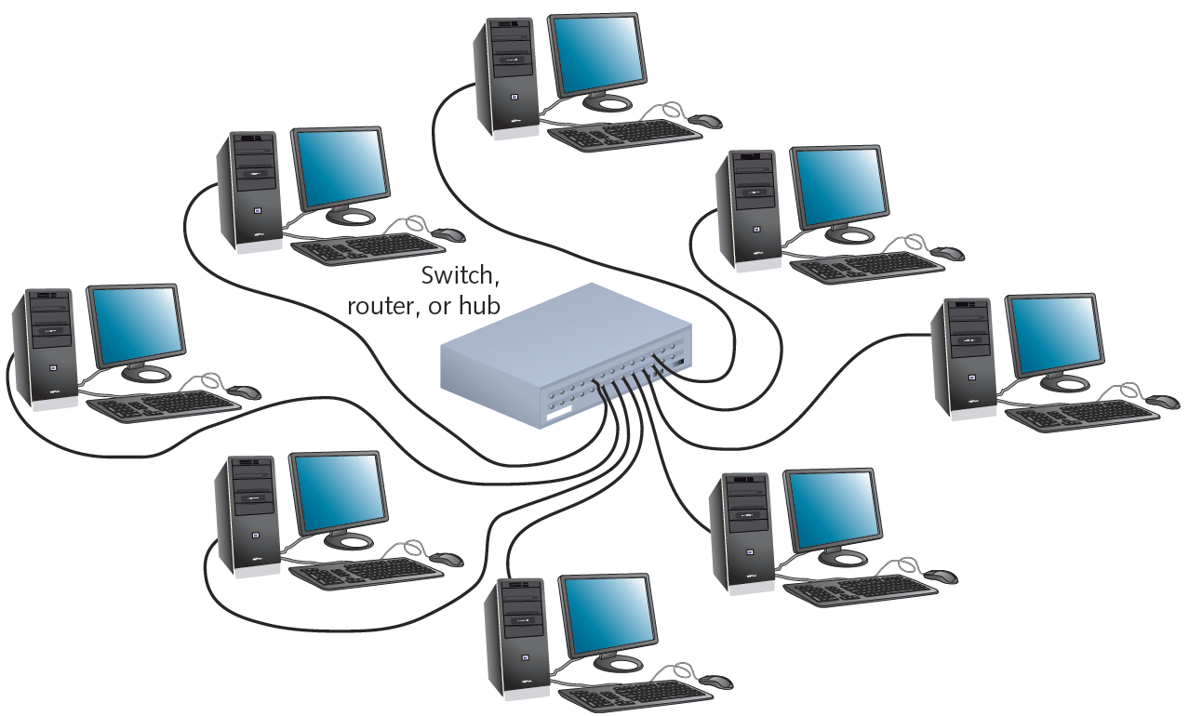
Star (cont’d.)
Most popular fundamental layout
Modern Ethernet networks based on star topology
1024 addressable logical network nodes maximum
Figure 5-3 A star topology network
Courtesy Course Technology/Cengage Learning

Slide 13
Hybrid Topologies
Pure bus, ring, star topologies
Rarely exist because too restrictive
Hybrid topology
More likely
Complex combination of pure topologies
Several options

Slide 14
Star-Wired Ring
Star-wired ring topology
Star physical topology
Ring logical topology
Benefit
Star fault tolerance
Network use
Token Ring networks
IEEE 802.5

Slide 15
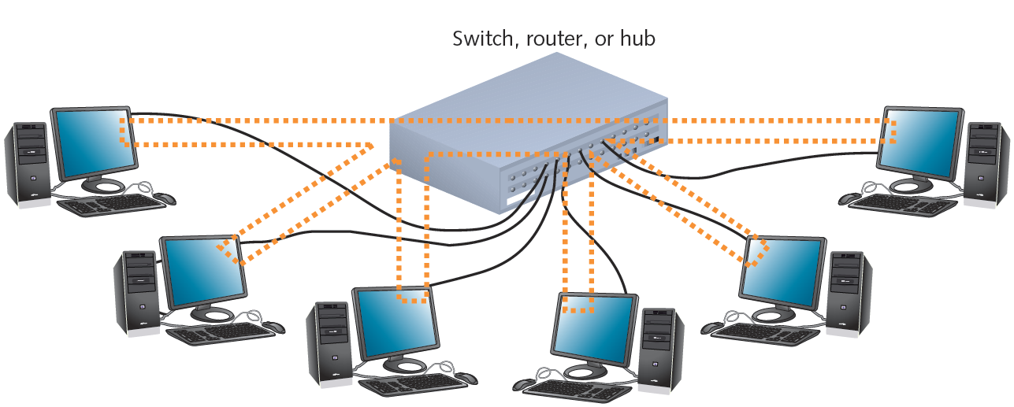
Star-Wired Ring (cont’d.)
Figure 5-4 A star-wired ring topology network
Courtesy Course Technology/Cengage Learning

Slide 16
Star-Wired Bus
Star-wired bus topology
Workstation groups
Star-connected devices
Networked via single bus
Advantage
Cover longer distances
Easily interconnect, isolate different segments
Drawback
Cabling, connectivity device expense
Basis for modern Ethernet networks

Slide 17
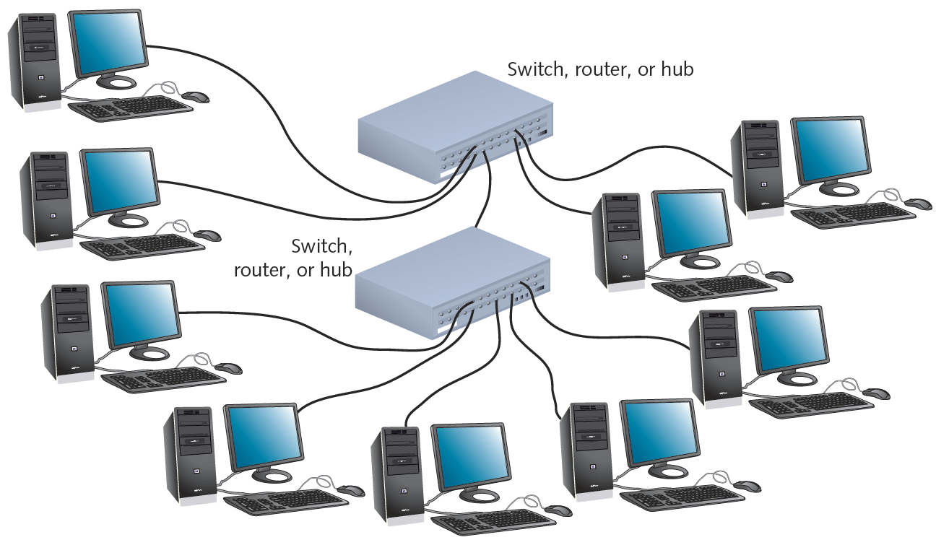
Star-Wired Bus (cont’d.)
Figure 5-5 A star-wired bus topology network
Courtesy Course Technology/Cengage Learning

Slide 18
Logical Topologies
Refers to way data transmitted between nodes
Rather than physical layout
Does not necessarily match physical topology
Most common: bus and ring
Broadcast domain
All nodes connected to single repeating device or switch

Slide 19
Backbone Networks
Cabling connecting hubs, switches, routers
More throughput
Large organizations
Fiber-optic backbone
Cat 5 or better for hubs, switches
Enterprise-wide network backbones
Complex, difficult to plan
Enterprise
Entire organization
Significant building block: backbone

Slide 20
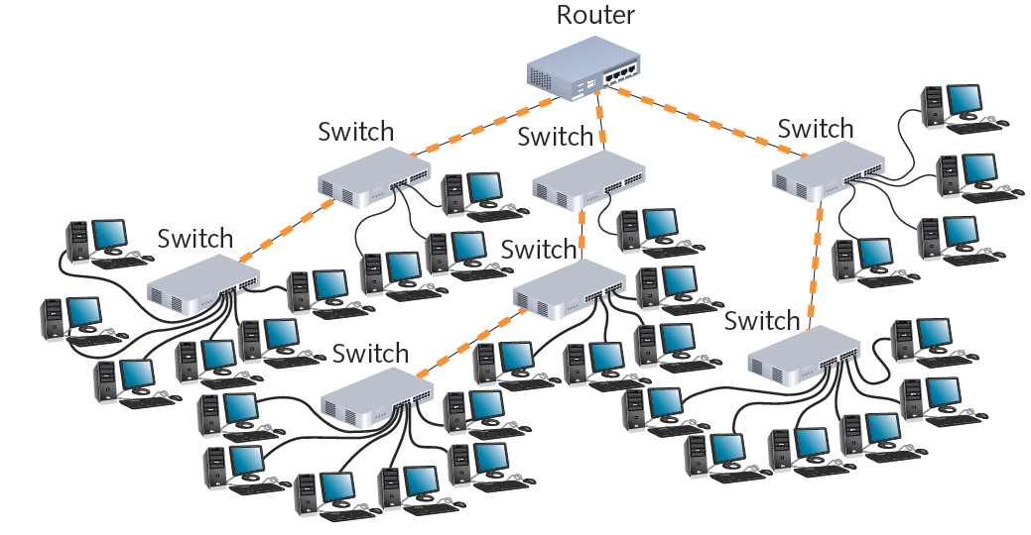
Figure 5-7 A simple distributed backbone
Courtesy Course Technology/Cengage Learning

Slide 21
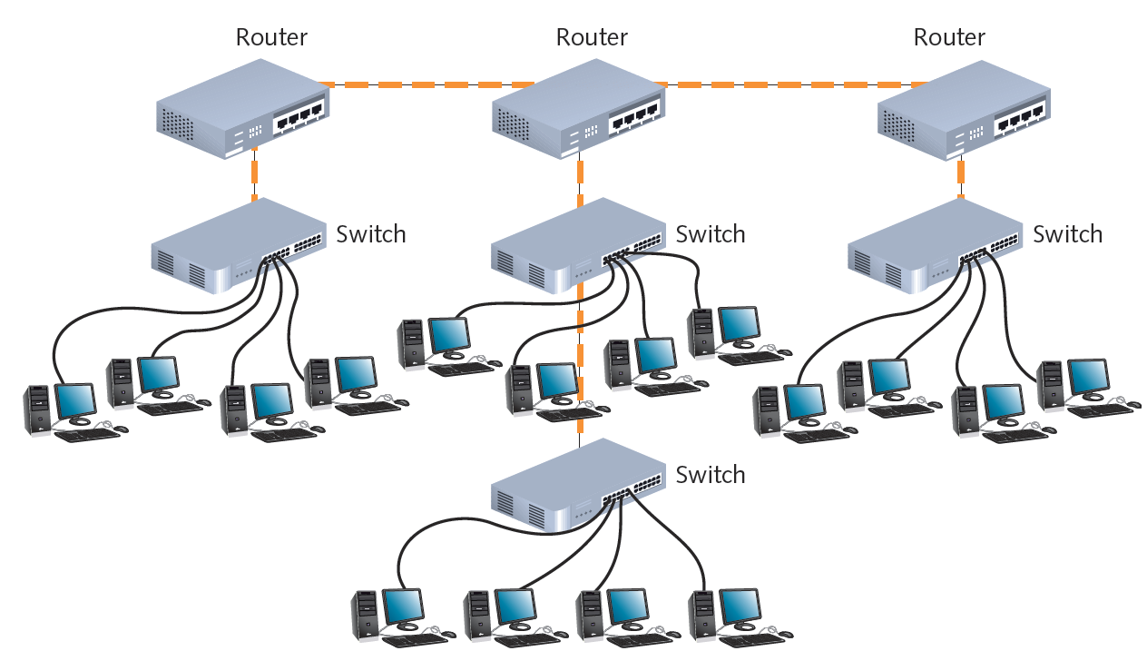
Figure 5-8 A distributed backbone connecting multiple LANs
Courtesy Course Technology/Cengage Learning

Slide 22
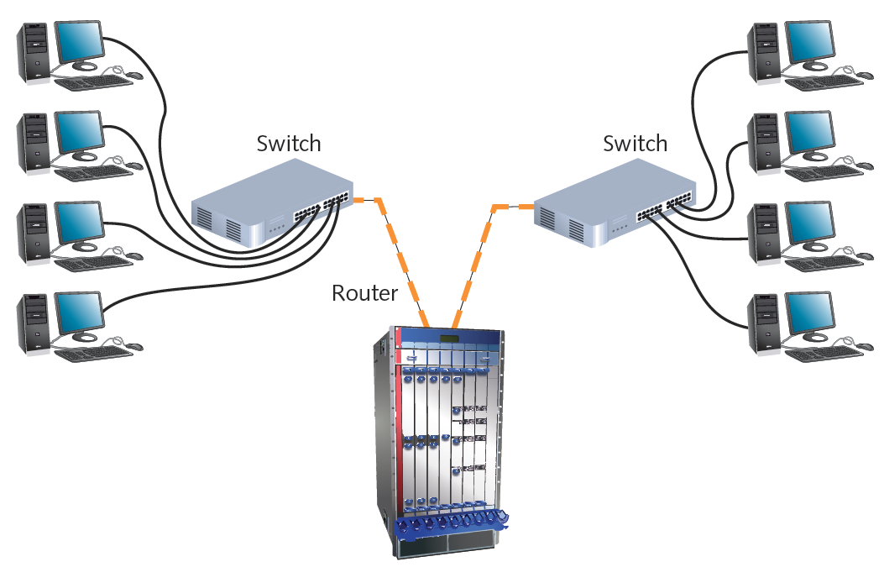
Figure 5-9 A collapsed backbone
Courtesy Course Technology/Cengage Learning

Slide 23
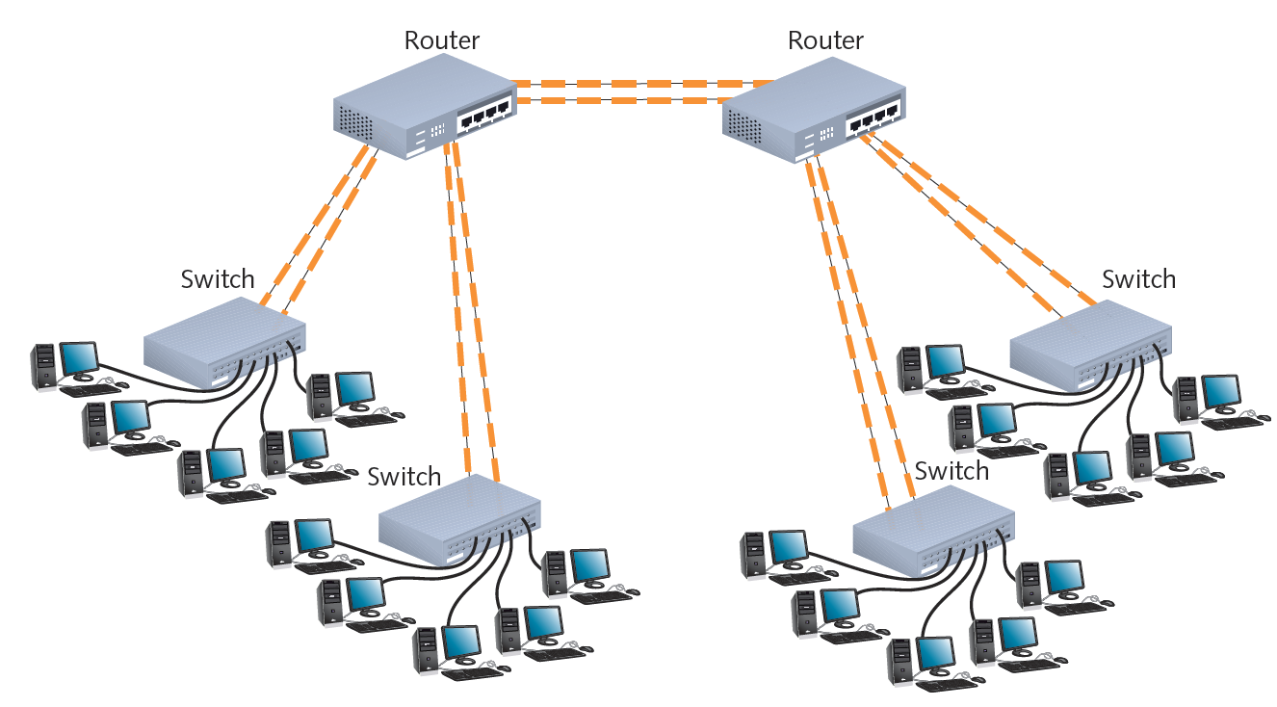
Figure 5-10 A parallel backbone
Courtesy Course Technology/Cengage Learning

Slide 24
Variations of Physical Topologies
The major physical topologies have three typical variations or combinations
Extended star
Mesh
Combination star and bus
These combinations can be used to get the most from any network

Slide 25
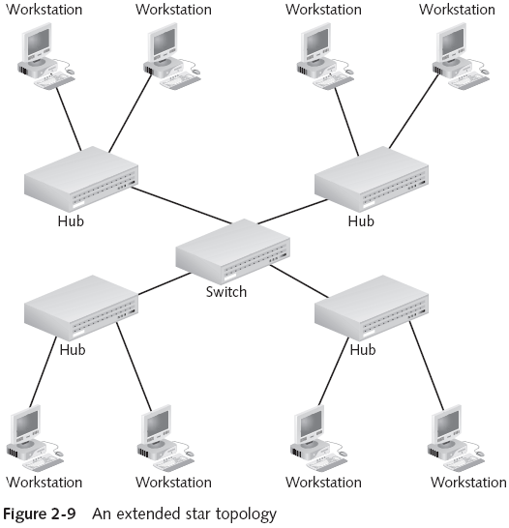
Extended Star Topology
Notes:
Most widely used on networks
Switch in the middle attached to hubs of star networks
That’s how Heritage network works

Slide 26
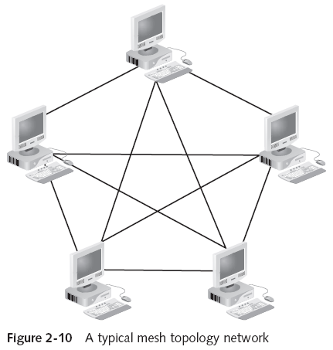
Mesh Topology
Notes:
Advantage – very fault tolerant
Disadvantage – most expensive
Every computer is attached to multiple other computers
Used in WANs, particularly high availability WANs
Internet is Mesh Topology – not entire one, just parts
Super computers are mesh technology as well

Slide 27
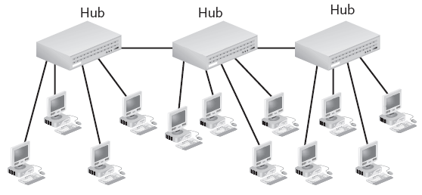
Combination Star Bus Topology
Notes:
A bus backbone connecting multiple hubs

Slide 28
Hubs
In everyday use, a hub is “the center of activity”
This definition is appropriate in network usage also
In network usage, there are a number of variations on this central theme
Active hub
Passive hub
Repeating hub (just a type of active hub)
Switching hub
Notes:
Both hubs and switches can act as the center of a star topology
Agora is the hub of the college
220 the hub of CS

Slide 29
Active Hubs
Most common type of hub today
Regenerate, or repeat, the signals
Require electrical power to run
Generally, have many ports—eight or more
Also called multiport repeaters or repeating hubs
Takes a signal coming in on one port
Cleans the signal (e.g., by filtering out noise)
Strengthens the signal
Sends the regenerated signal out to all other ports
Drawback: require sharing the cable bandwidth among all connected stations
Notes:
Sometimes called repeaters
Because they regenerate signals they need power to run
Can become a bottleneck 10 Mbps Ethernet hub with 5 devices attached is effectively 2 Mbps
Did used to be a problem, but with multimedia it is becoming one

Slide 30
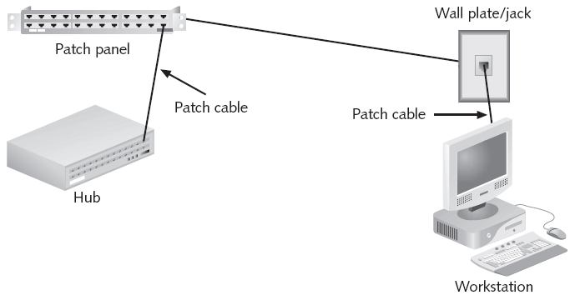
Passive Hubs
Notes:
Patch panel is a passive hub
Does not amplify or regenerate, just passes things on
Just a central connection point – like box in corner of 221 lab

Slide 31
Switches
Central connecting point in a star topology network
Does more than simply regenerate signals
Looks just like a hub, with several ports for connecting workstations in a star topology
Determines to which port the destination device is connected and forwards the message to that port
This capability allows a switch to handle several conversations at one time, thereby providing the full network bandwidth to each device rather than requiring bandwidth sharing
Notes:
Looks like a hub but is smarter

Slide 32
Constructing a Network Layout
The first step in any network design is to evaluate the underlying requirements
First determine how the network will be used, which often decides the topology you use
Decide the types of devices for interconnecting computers and sites
Finally, the type and usage level of network resources dictates how many servers you need and where to place servers
Notes:
A lot of printers or file servers. Web servers, need something reliable
Usage level determines topology

Slide 33
Selecting a Topology
Most new network designs come down to only one choice: How fast should the network be?
The physical topology will certainly be a star, and the logical topology is almost always switching
Ethernet switches are typically used on a LAN, but you might consider other logical topologies for other reasons:
Use of legacy equipment
Network size
Cost restrictions
Difficulty to run cables
Notes:
Legacy equipment for FDDI rings
Hub-based for small networks
Hub may be good for a few computers being added to an existing network in a remote location (RCMP)
Wireless for add ons to existing wired network or remote locations
Tough to run cables…laptop in a house, stone building, etc

Slide 34
Creating the Layout
Network must be documented
Useful questions before drawing the diagram
How many client computers will be attached?
How many servers will be attached?
Will there be a connection to the Internet?
How will the building’s physical architecture influence decisions, such as whether to use a wired or wireless topology, or both?
Which topology or topologies will you use?
Network diagram must be kept up to date

Slide 35
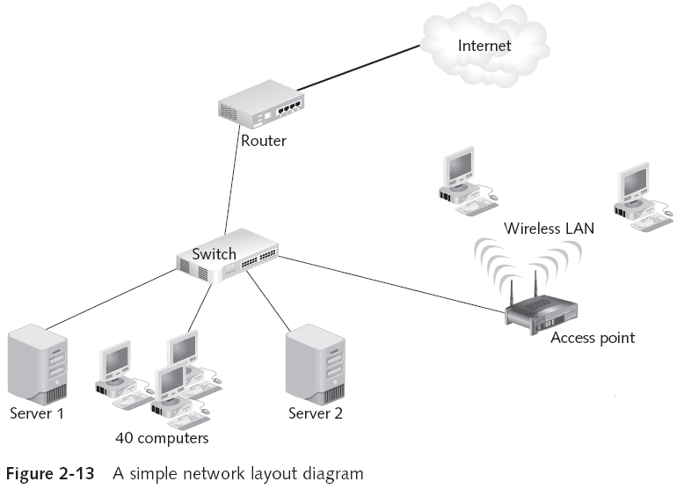
Creating a Layout
Notes:
How many computers are attached? 42
How many servers? 2
Is there a connection to the internet? Yes
How is physical layout affecting the topology? 2 need wireless access
What topology(ies) are used? Switching & wireless – Star Switch

